Slide 1
Data and Algorithm 12
Chulalongkorn University
School of Integrated Innovation
Fall 2023
Marko Niinimaki Marko.N@chula.ac.th

Slide 2
Today’s main topics
Where is data? In programs/files/databases/blockchains/the web/the cloud.
From last week: IaaS/PaaS/SaaS
How does text search work?
Building a web application that searches documents “your own Google”.

Slide 3
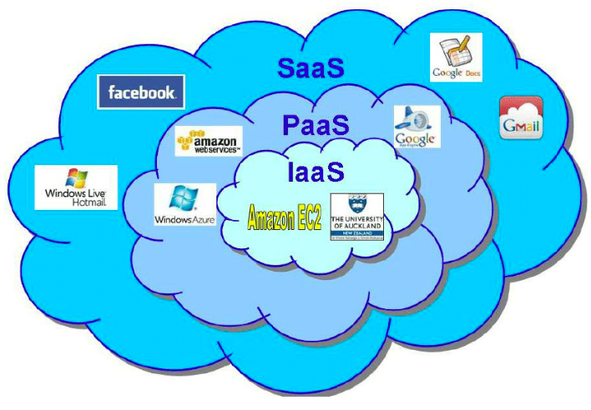
"Cloud service models"
WordPress as an example.
You get a virtual machine from a cloud provider like Amazon AWS or Google Cloud. You install and configure WordPress yourself: IaaS.
You get a ready-made WordPress installation from WordPress.com or another hosting service like GoDaddy: SaaS.
You use WordPress as an API and write applications that use the API in the cloud: PaaS.
What is a virtual machine?

Slide 4
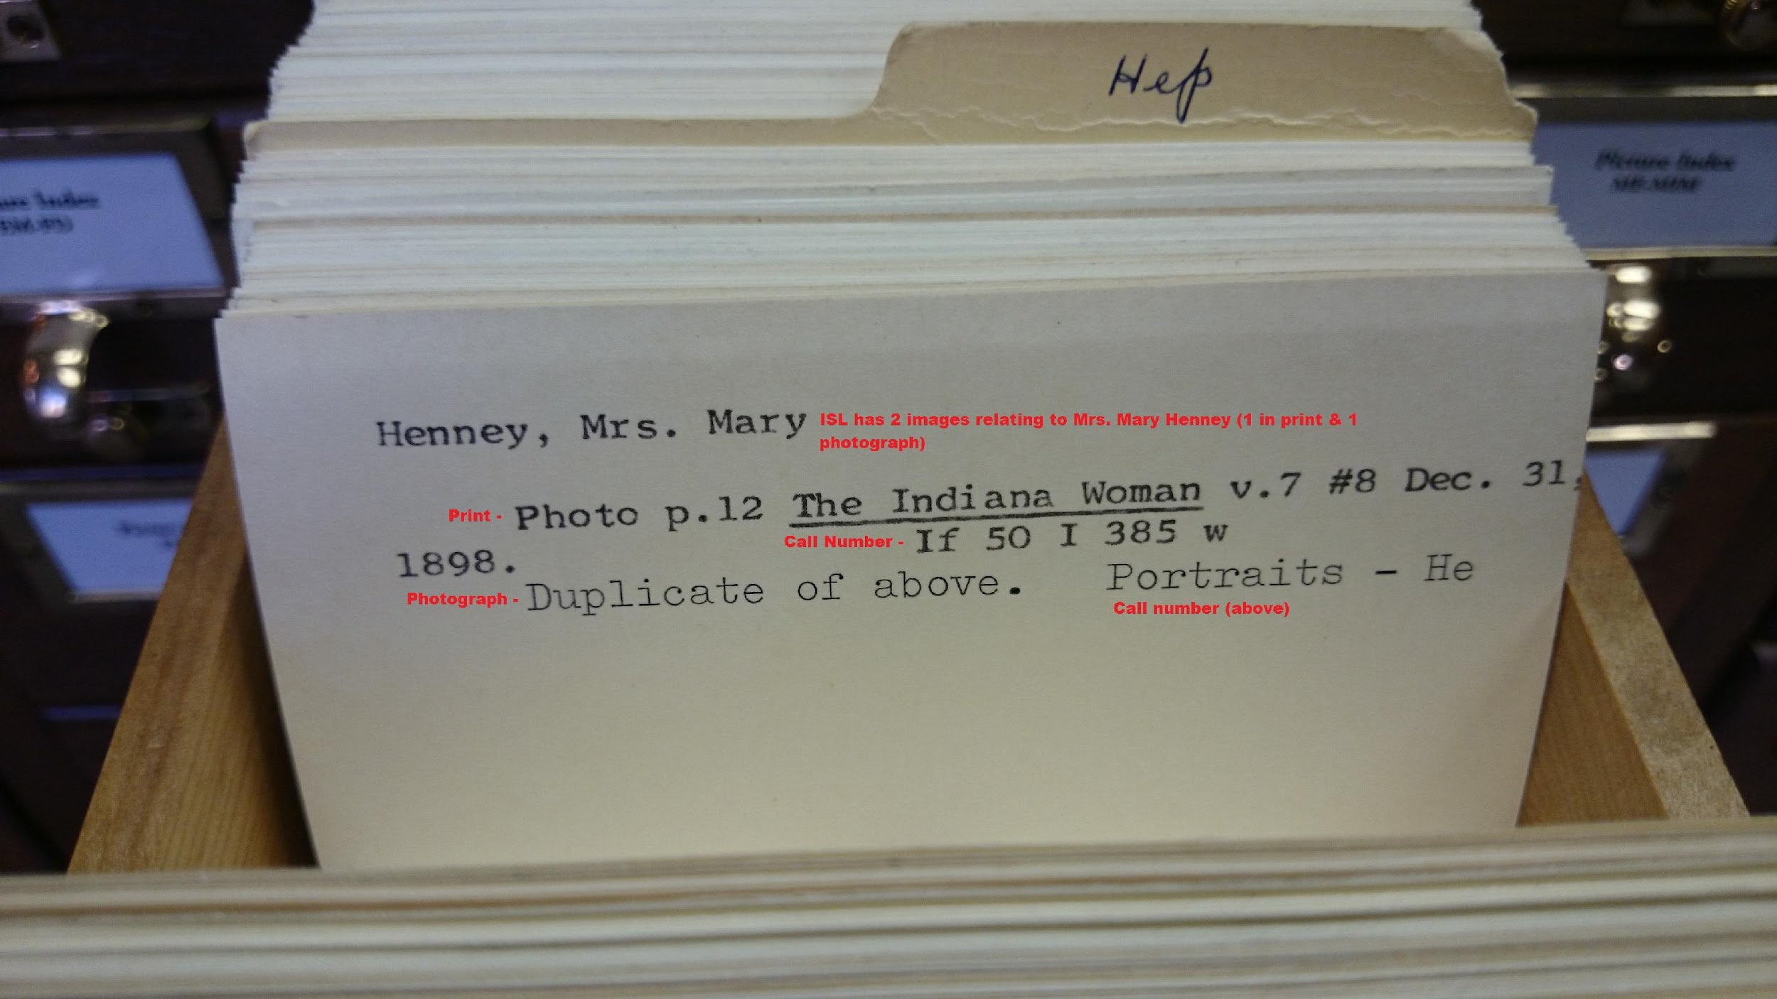
Text fields
Relational databases are very good for data management as far as the data is “atomic”, field-based and conforms to traditional types (integer, char,..)
This could be “metadata” like bibliography records (picture copyright Indiana city library)
The following slides show a simple table design for such metadata (for serious designs there is a standard called MARC).

Slide 5
Information retrieval 1/2
Background theory G. Salton.
Precision = Total number of documents retrieved that are relevant/Total number of documents that are retrieved. Recall = Total number of documents retrieved that are relevant/Total number of relevant documents in the database.
What is “relevant”. In this case simply: the document has the word(s) that we use in the query.
“More relevant”: the words appear often in the document, considering the total number of words in the document.

Slide 6
Information retrieval 2/2
This method is too simple because it ignores contexts like “this document is not about cats”. It would still think it’s relevant because of the word cat.
Store document information: For every document, build a list of the words in the document divided by the total number of words. Ignore “stop words” like “a”, “the”, “in”, “and” etc
Example: the chula.ac.th/en front page has (currently) 2086 words. 18 of them are “Chulalongkorn” -> 18/2086 (“score”).
Retrieve: find the document with the highest score for the word you are searching.

Slide 7
Database design
All publications have an id, title, maybe an isbn, publication date, download url, authors. publishers in separate tables
PID | AUTHOR | TITLE | ISBN | PUBDATE | URL
1 | Jane Austen | Pride and Prejudice |  | 2006-10-17
2 | O. Henry | The Gift of the Magi |  | 2011-12-11
NAME | PUBID
Project Gutenberg | 1
Project Gutenberg | 2

Slide 8
Contents
We could store the text of Pride and prejudice into 1.txt, the Gift of the magi into 2.txt and manage them separately (not with sql).
But for many applications a full text search is needed. even standard sql has ‘like’ operator: select <fields> from <tables> where column like ‘%word%’;
For many practical purposes this is insufficient. “column like ‘%word%’” returns true/false. we are often interested how many times the word appears proportional to the total number of words in the text (“score”).

Slide 9
Text fields in a relational database
Many rel.dbms’s support the text data type and allow “unconventional” search operations to text fields.
Warning: this (probably) breaks the semantics of the relational model/relational algebra.
But we’ll get the ability to express queries: list documents by author a, order by “score” of word w.

Slide 10
Design again
PUBLICATIONS
PUBLISHERS
TEXTS (BODY TYPE IS TEXT) ..
OR MEDIUMTEXT
PID | AUTHOR | TITLE | ISBN | PUBDATE | URL
1 | Jane Austen | Pride and Prejudice |  | 2006-10-17
2 | O. Henry | The Gift of the Magi |  | 2011-12-11
NAME | PUBID
Project Gutenberg | 1
Project Gutenberg | 2
BODY | PUBID
Chapter 1 It is a truth.. | 1
One dollar and.. | 2

Slide 11
A Searchable Text Field/Table 1/4
//NOTE: YOU NEED TO REPLACE SINGLE QUOTES BY \’ IN THE TEXT CONTENTS
CREATE TABLE PUBLICATIONS(PID INTEGER, AUTHOR VARCHAR(100), TITLE VARCHAR(100), PUBDATE DATE, ISBN VARCHAR(14), URL VARCHAR(100), PRIMARY KEY(PID));
CREATE TABLE TEXTS (BODY MEDIUMTEXT, FULLTEXT(BODY), PUBID INTEGER, FOREIGN KEY(PUBID) REFERENCES PUBLICATIONS(PID));
INSERT INTO PUBLICATIONS VALUES (1,”Jane Austen”, ”PRIDE AND PREJUDICE”,2006-10-17,NULL, NULL);
INSERT INTO PUBLICATIONS VALUES (2,”O. Henry”, ”THE GIFT OF THE MAGI”,2011-12-11,NULL,NULL);
INSERT INTO TEXTS VALUES (‘’’Chapter 1 It is a truth universally acknowledged, that a single man..’’’,1);
INSERT INTO TEXTS VALUES (‘’’One dollar and eighty-seven cents..’’’,2);
Test:
SELECT PUBID FROM TEXTS WHERE MATCH(BODY) AGAINST('acknowledged');
1

Slide 12
A Searchable Text Field/Table 2/4
HOW MANY TIMES DOES WORD “LOVE” APPEAR IN THE GIFT OF THE MAGI? 3 TIMES.
SELECT LOCATE("LOVE", BODY) FROM TEXTS WHERE PUBID=2;
5503
SELECT LOCATE("LOVE", BODY, 5504) FROM TEXTS WHERE PUBID=2;
6708
SELECT LOCATE("LOVE", BODY, 6709) FROM TEXTS WHERE PUBID=2;
8158
SELECT LOCATE("LOVE", BODY, 8159) FROM TEXTS WHERE PUBID=2;
0

Slide 13
A Searchable Text Field/Table 3/4
WE CAN EXTRACT THE “SNIPPET” OF ANY INSTANCE OF THE WORD (HERE: FIRST)
SELECT LOCATE("LOVE", BODY) FROM TEXTS WHERE PUBID=2;
5503
SELECT SUBSTRING(BODY,5503-10,50) FROM TEXTS WHERE PUBID=2;
ADDED TO LOVE. WHICH IS ALWAYS A TREMENDOUS TASK

Slide 14
A Searchable Text Field/Table 4/4
MYSQL SUPPORTS A “SCORE” OPERATION: MATCH(FIELD) AGAINST(WORD) RETURNS THE SCORE OF THE WORD
SELECT PUBID, MATCH(BODY) AGAINST ('gift') AS SCORE FROM TEXTS;
ID | SCORE
1 | 0
2 | 0.0906190574169159
Notes:
select * from PUBLICATIONS where pid=27327;

Slide 15
Summary/Notes
If you need a database application with (some) text search abilities, you can do it with a relational database like mysql.
The max size of a text field is ~2 million char.
There are specialized text indexing/searching software packages like Lucene. They are useful if you need to import/extract/parse text from pdf or html files.
WordPress uses MySQL as a database and has decent text search functions but its search/retrieval mainly is about WordPress posts/articles.

